Slide 1
How To Get Bonded

Slide 2
What Is A Surety Bond?
A key risk management tool in infrastructure development
    A surety bond is a written, three-party agreement—often required by law—that guarantees performance or payment of another party’s obligation under a contract, law, or regulation
The Three Parties Involved
    SURETY - The insurance company that guarantees the performance or payment of the principal’s obligation
    OBLIGEE – The party protected by the bond (e.g., a government agency or project owner)
    PRINCIPAL - The contractor or business responsible for fulfilling the obligation (e.g., completing a project or complying with a law)
Purpose of a Surety Bond
    To ensure obligations are met—if the principal fails, the surety steps in to fulfill the obligation or compensate the obligee

Slide 3

Step 1: Identify A Project
Identifying a project and reviewing the bonding requirement is the first step in getting bonded
Where to Find Project Opportunities
    Trade associations
    Architect and engineering firms
    General Contractors
    Federal, state and local government agencies
  Next Steps
    Review the request for proposal (RFP) and project contract
    Focus on project specifications/ contractual obligations
  Ask Yourself
      Does your company have the resources to complete the work?
      Do you have the necessary licenses and qualifications?
      Do you have the cash flow to fund the project?

Slide 4
Step 2: Involve a Bond Producer
After identifying a project, the next step is to find a qualified bond producer to guide you through the bond application process.
Where to Find a Bond Producer
    NASBP’s Surety Pro Locator - A national directory of producers by state
    Industry contacts - Ask colleagues, GCs, or trade associations for referrals
  What to Look For in a Bond Producer
    Experience with construction surety bonds
    Strong construction industry network
    Familiarity with your local market
  Prepare to Share With the Producer
    Your work experience
    Your company’s competitive advantages
    Any known business challenges

Slide 5
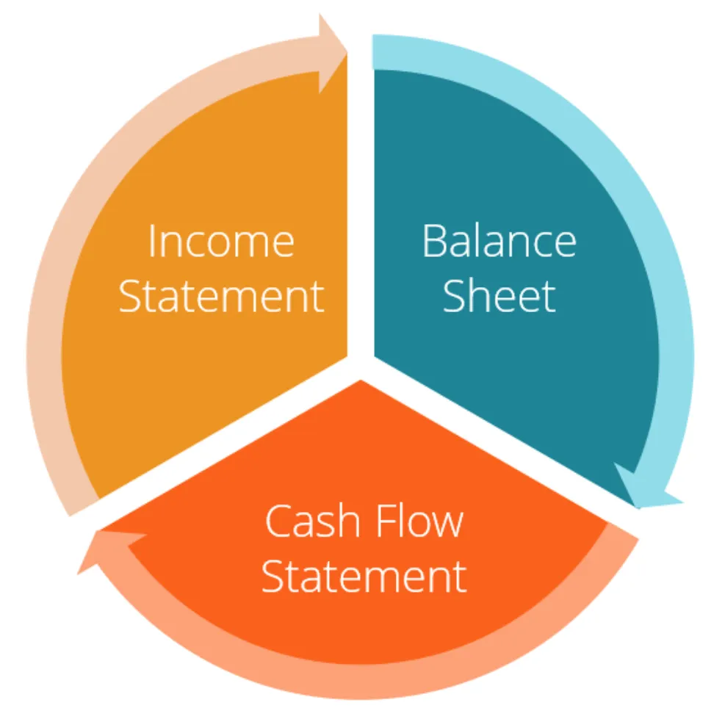
Step 3: Gather Documents
Each surety company may request different information - but most will require key documents to begin the bonding process
Commonly Requested Documentation
    Social security numbers (owners/ partners)
    Employer Identification Number (EIN)
    Valid photo ID
    Business and personal tax returns
    Year-end financial statements
    List of completed projects or contracts
    Job cost breakdowns
    Business and trade references
    Credit scores (personal and/or business)

Slide 6
Step 4: Review Indemnity Requirements
Surety bonds are not traditional insurance—sureties are indemnified from loss, meaning they must be repaid if they cover a claim
What is an Indemnity Agreement?
    A legal contract that guarantees the contractor (and others, if required) will reimburse the surety for any covered losses
  Who Signs the Agreement
    The company seeking the bond
    The contractor
    Other parties, if necessary (spouse or domestic partner)
  Role of the Bond Producer
    Explain who must sign
    Clarify the terms, obligations and risks

Slide 7
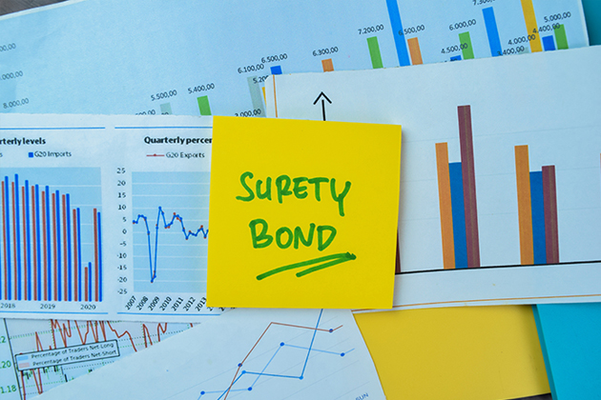
Step 5: Apply For The Bond
Once you’ve selected a project and gathered your documents, it’s time to complete and submit the bond application.
Types of Bond Applications
    Bid Bond Request Forms
      Required if the project owner requires a bid bond
      Submitted with the contractor’s bid
    Performance and Payment Bond Request Form
      Required if the project owner awards the contract directly to the contractor
      Also required when a subcontractor must bond to a General Contractor
  What’s Next
    Submit the completed application with supporting documents
    Your bond producer may follow up with questions to refine or clarify the application

Slide 8
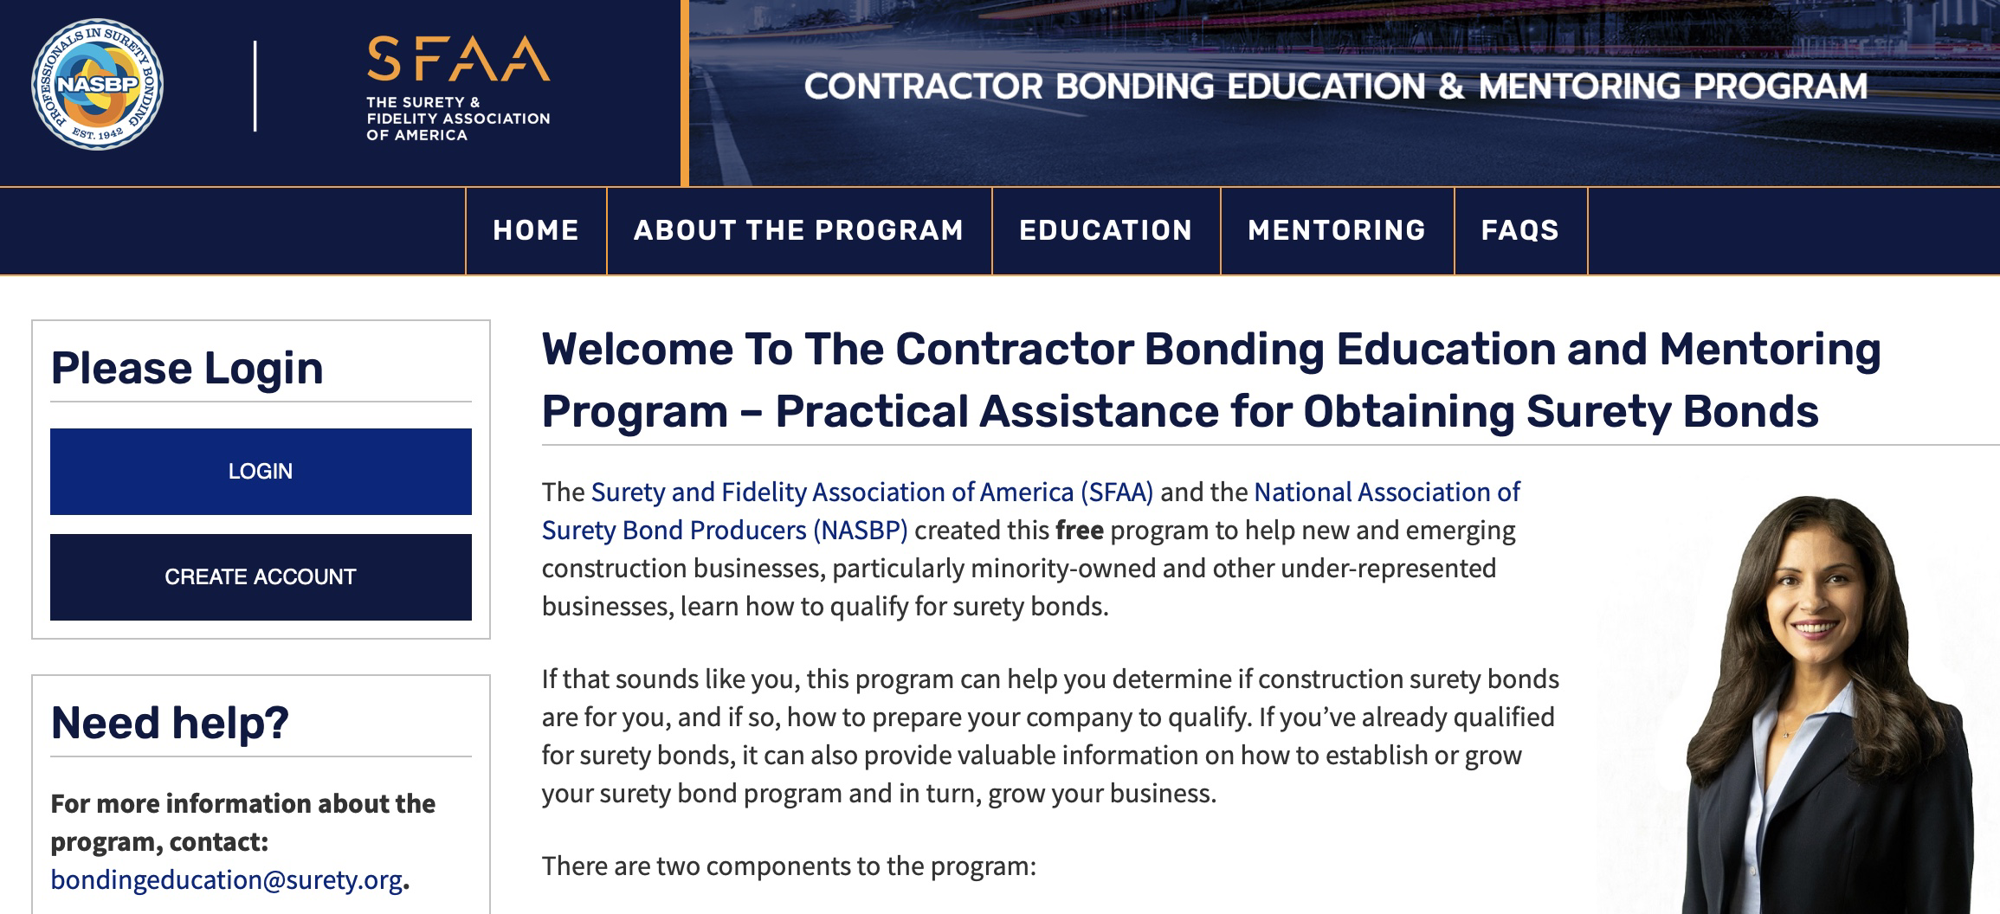
Contractor Bonding Education And Mentoring Program
The Surety & Fidelity Association of America (SFAA) and the National Association of Surety Bond Producers (NASBP) offer a free, online course for new and emerging contractors
What You’ll Learn
    Bonding fundamentals
    How to qualify for a bond
    Working with surety bond producers
    Real-world examples and insights
Get Started
    Visit www.contracorbondinged.org

Slide 9
Thank You

